Slide 1

Business Presentation for Ao Neko Online Music Store
Presented By.
Thiha Kyaw

Slide 2

Content
About the System
Aim of the System
Objectives of the System
Advantages and Limitations of the System
Functional Scope
Development Architecture

Slide 3

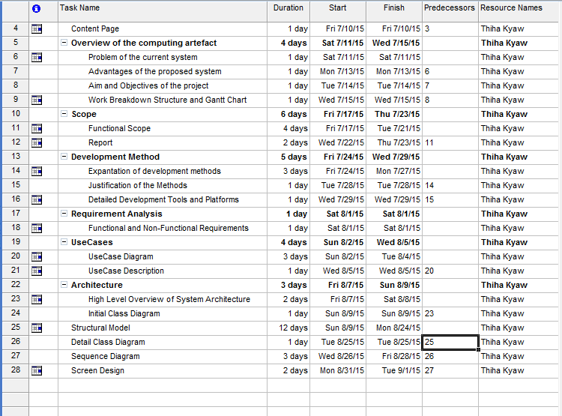
Work Breakdown Structure

Slide 4
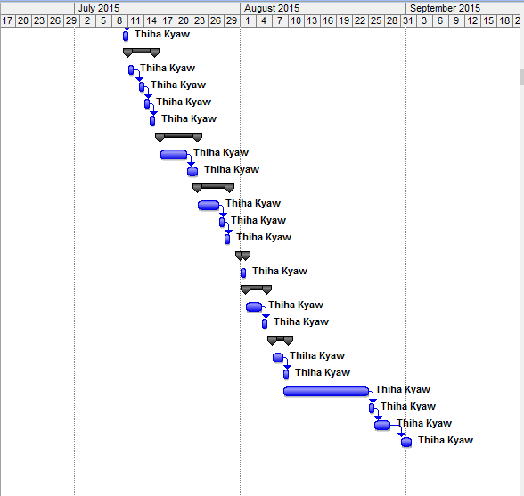
Gantt Chart

Slide 5
About the system
It is the Online Music Source
It is a Dynamic Website
It is Easy to use

Slide 6
Aim of the System
Remove the old website design (static website).
Remake the new website (dynamic website) design.
It will be with customer registration system and purchasing system.

Slide 7
Objectives of the System
Remake a new website
Add Data Server for storing data
Create a database of this store
Hire staff to make website active
Contact with music companies and artists for pre-order system
Hire web designers to improve web design to latest

Slide 8
Advantages of the system
It is easy to use.
Design is improved
Able to purchase to music digitally.

Slide 9
Limitation of the system
Customer must purchase album with the top up bill (No Banking, No Online Payment)
Customers cannot purchase anything without signing up.

Slide 10
Functional Scope -1
Applicant Scope
Sign up in the website.
Top-up the prepaid card
Search for the album
Purchase and Download

Slide 11
Functional Scope -2
Staff Scope
Check the customer’s money amount in the account
Send the activation code of song via email
Save the purchased user account to retrieve later.

Slide 12
Functional Scope-3
Report
Provide the weekly report for admin
Provide Product List
Provide Staff List
Provide Bank Staff List

Slide 13

Development Architecture
Programming Language
Php
MySQL
jQuery
Bootstrap
JavaScript
Software
XAMPP
Bracket IDE

Slide 14

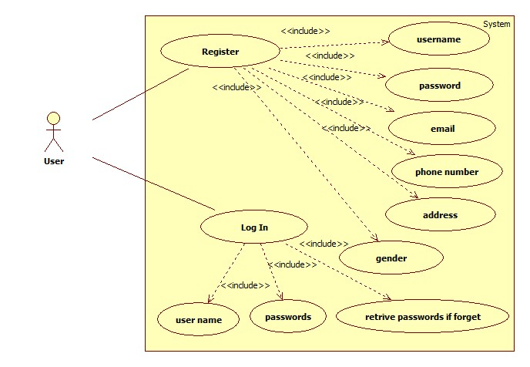
Usecase Diagram
Figure (1.A) User Registration.

Slide 15
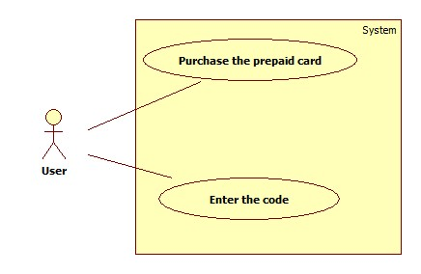
Fig (1.B) Topup the Balance

Slide 16
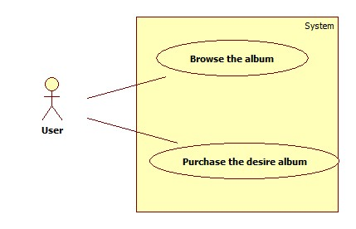
Fig (1.C) Browse and Purchase

Slide 17
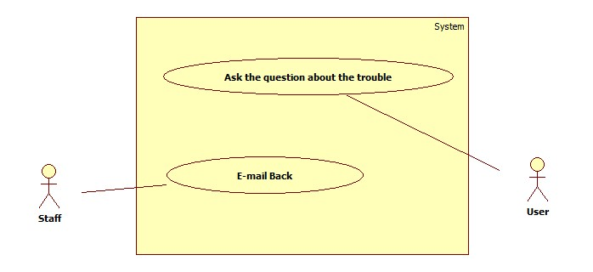
Fig (1.D) User asking the problem he have on using website

Slide 18
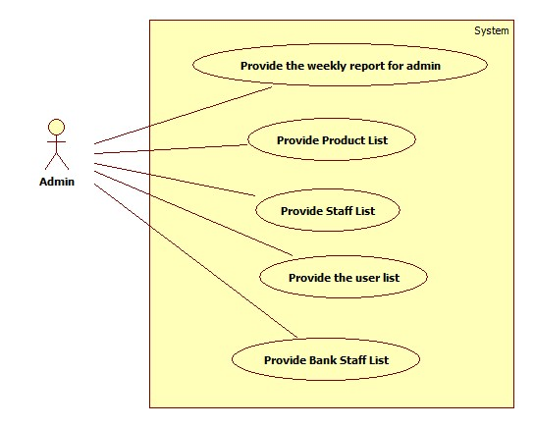
Fig (1.E) Admin Report

Slide 19
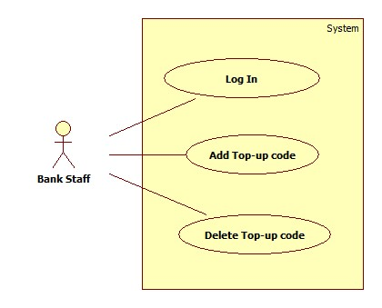
Fig (1.F) Bank Staff’s process

Slide 20
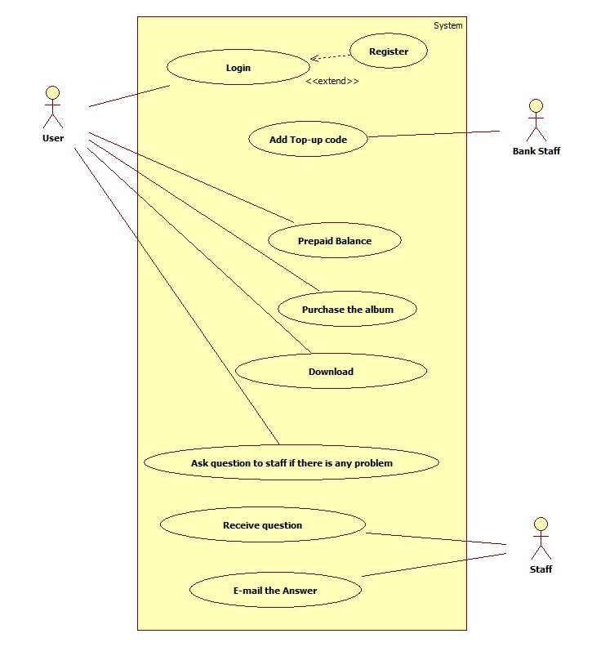
Fig (1.G) Overall

Slide 21
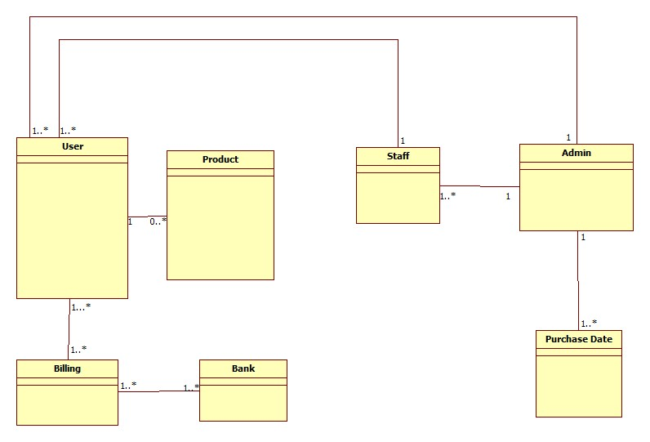
Class Diagram
Fig (2) Initial Class Diagram

Slide 22
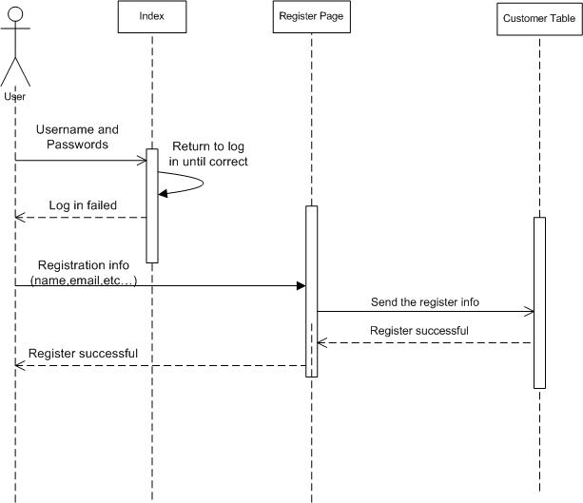
Sequence Diagram
Fig (3.A) User Registration

Slide 23
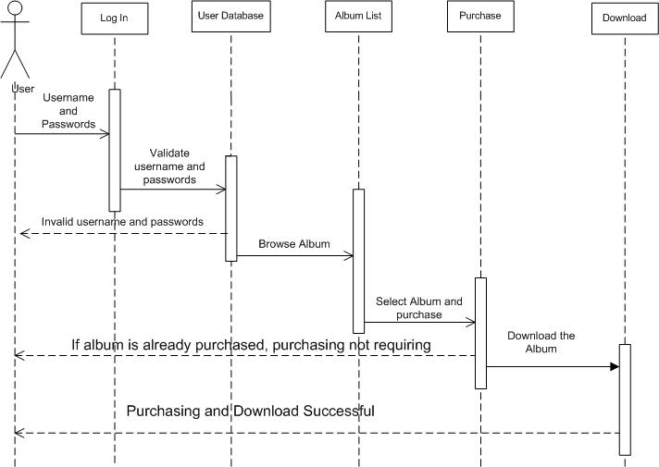
Fig (3.B) Purchasing Album

Slide 24
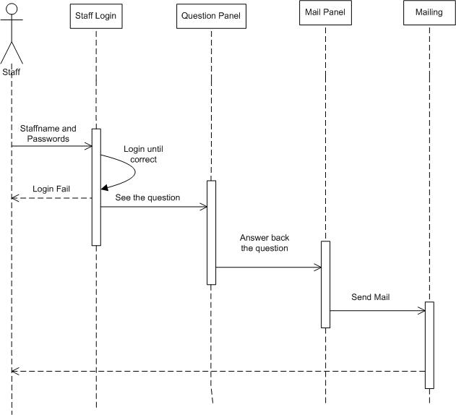
Fig (3.C) Staff Panel

Slide 25
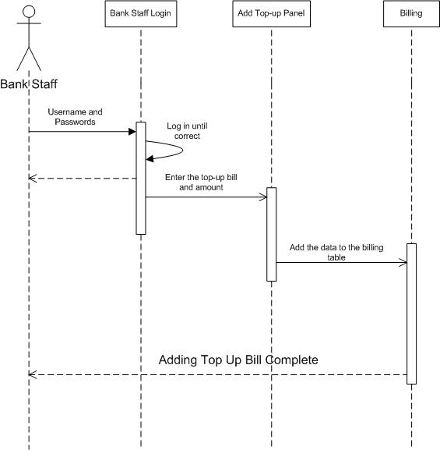
Fig (3.D) Bank Staff Panel

Slide 26

UI Prototype
Fig (4.A) Home Page

Slide 27
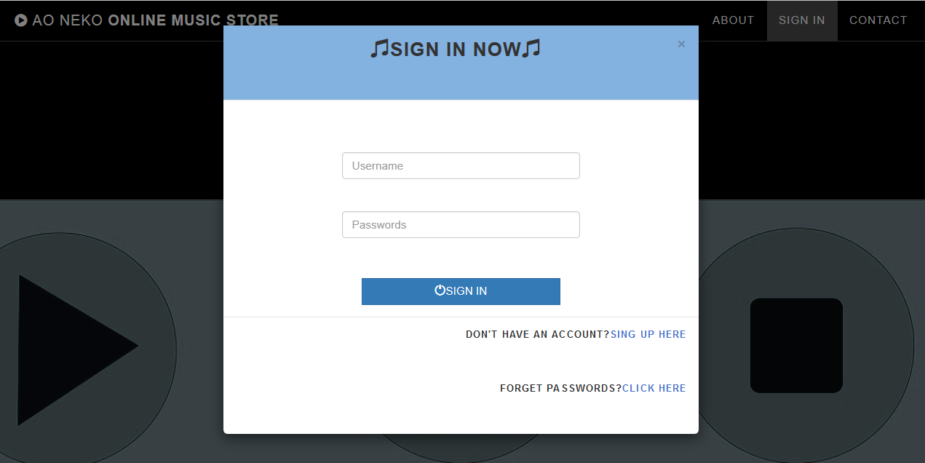
Fig (4.B) User Sign in Modal

Slide 28
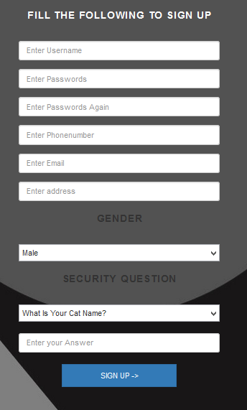
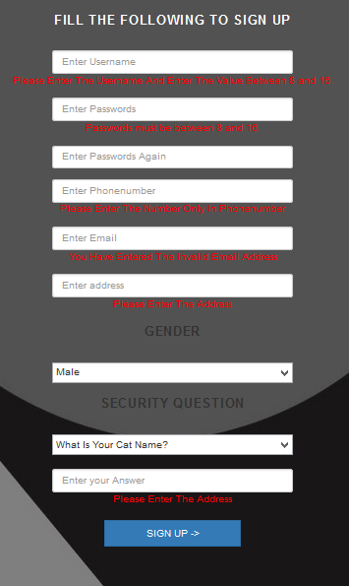
Fig (4.D & 4.E) User Registration

Slide 29
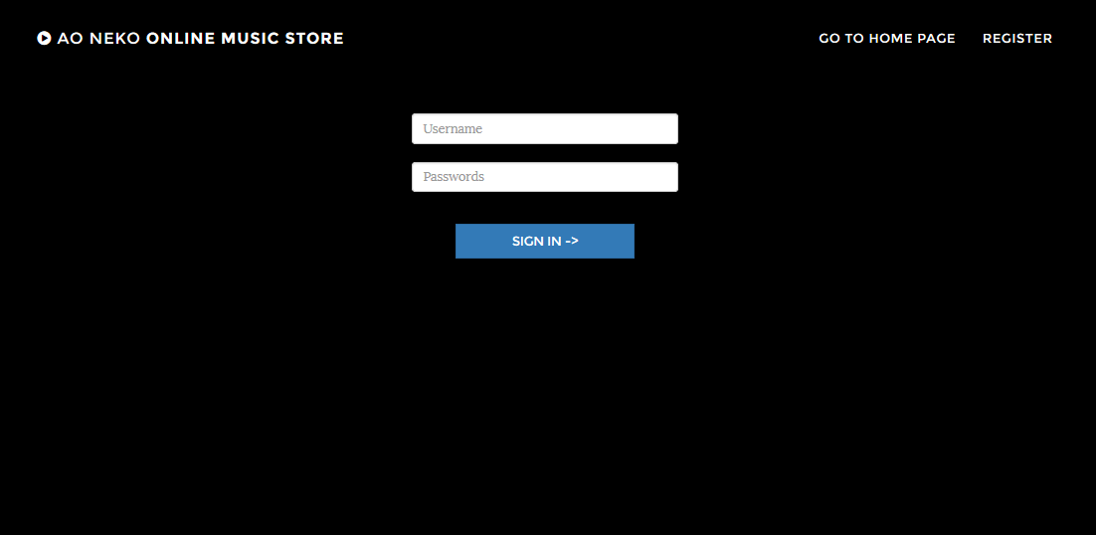
Fig (4.F) User Sign In Page

Slide 30
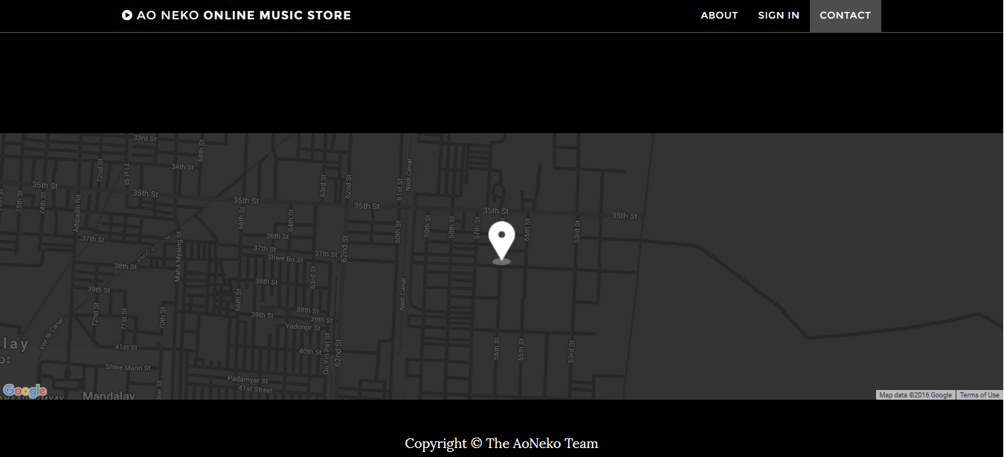
Fig (4.F) Map API

Slide 31
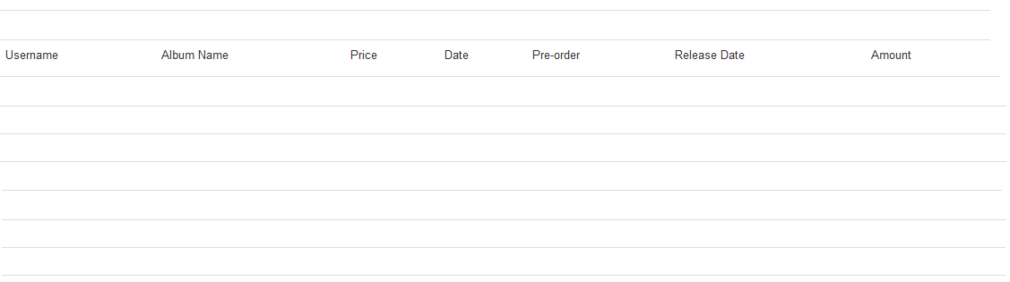
Fig (4.G) Review Prototype

Slide 32
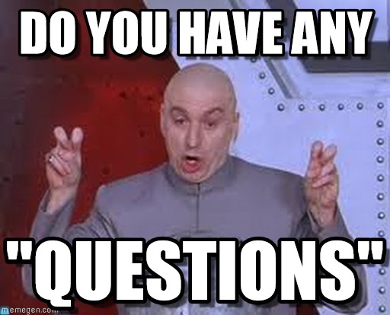

Slide 33







